Slide 1

What’s new in .NET Aspire
Maddy Montaquila
Damian Edwards

Slide 2
Intro – what is Aspire?
Inner loop
Wait for, health checks, Dockerfile, python, docker compose
Dev Dashboard
Stop/restart, custom commands
Agenda
Integrations
CommunityToolkit, Azure Functions, AWS
Deployment
CDK constructs, whatever
More?
Notes:
Things to show:
Main thing to focus on is getting the updated messaging across
Only 45 mins slot, allow 5 mins buffer, so target 40 mins content
Slide-driven talk
WaitFor & health checks
AddDockerfile from the eShopSupport sample for Python app
Custom commands
Samples repo, some key samples?
Slide for Azure Functions preview support & shout out to Safia’s talk
Slide on the Azure CDK/constructs stuff
Some comparison to Docker Compose, e.g. compare a docker compose file to an app host
Highlight the AWS integrations moving to their repo as first example of curated integrations expanding outside our repo
Announce the Community Toolkit!
Something, something deployment

Slide 3

Get .NET 9
Download .NET 9 aka.ms/get-dotnet-9

Slide 4
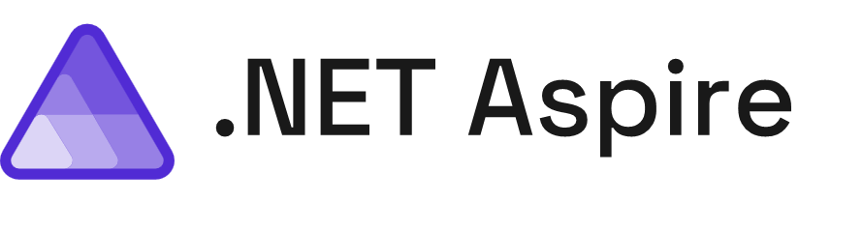
Build, test, and deploy apps seamlessly from code to cloud
Streamlined Inner-Loop
Developer Dashboard
Integrations
Deployment
Extensible, OpenTelemetry Built-in, & Ready for Any Cloud
Notes:
.NET Aspire is a collection of flexible tools, opinionated templates, and curated packages for modern developers. Aspire simplifies managing projects, resources, containers, microservices, and more – at development time while you write code.
Plus, Aspire gives you real-time insights into your app while you’re actively developing it – no more pushing to staging environments or production to see how your changes play with the rest of your stack.
We’ve worked with a bunch of popular cloud library and service authors to create integrations that simplify setting up and managing all of the various resources we need to build production apps at scale, and to help you build secure-by-default apps in a world where cyberattacks just don’t stop.
We’ve also worked with teams in Azure and AWS to simplify basic deployments to get your apps up and running, and your fixes shipped to your customers, faster than ever.
I’ve had the privilege of working on Aspire the past few months with a ton of amazing engineers and architects, including Damian – what’s up d00d

Slide 5
.NET Aspire by the numbers
Nearly 50k users since GA
3.8k stars on GitHub
Over 150 contributors

Slide 6
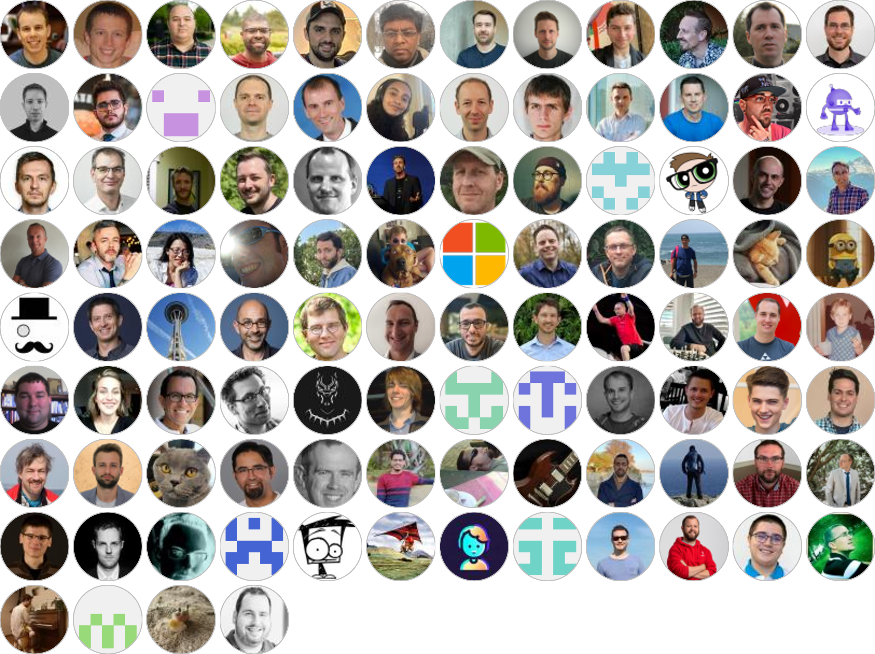
THANK YOU

Slide 7
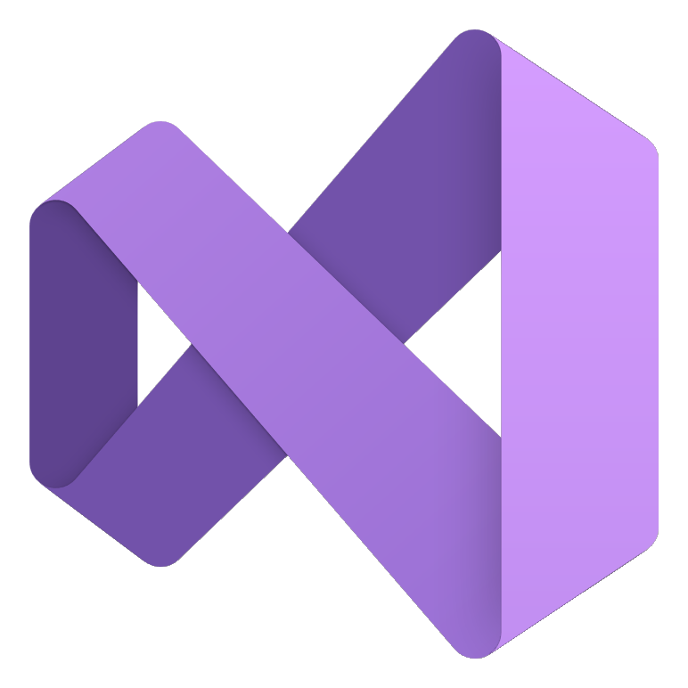
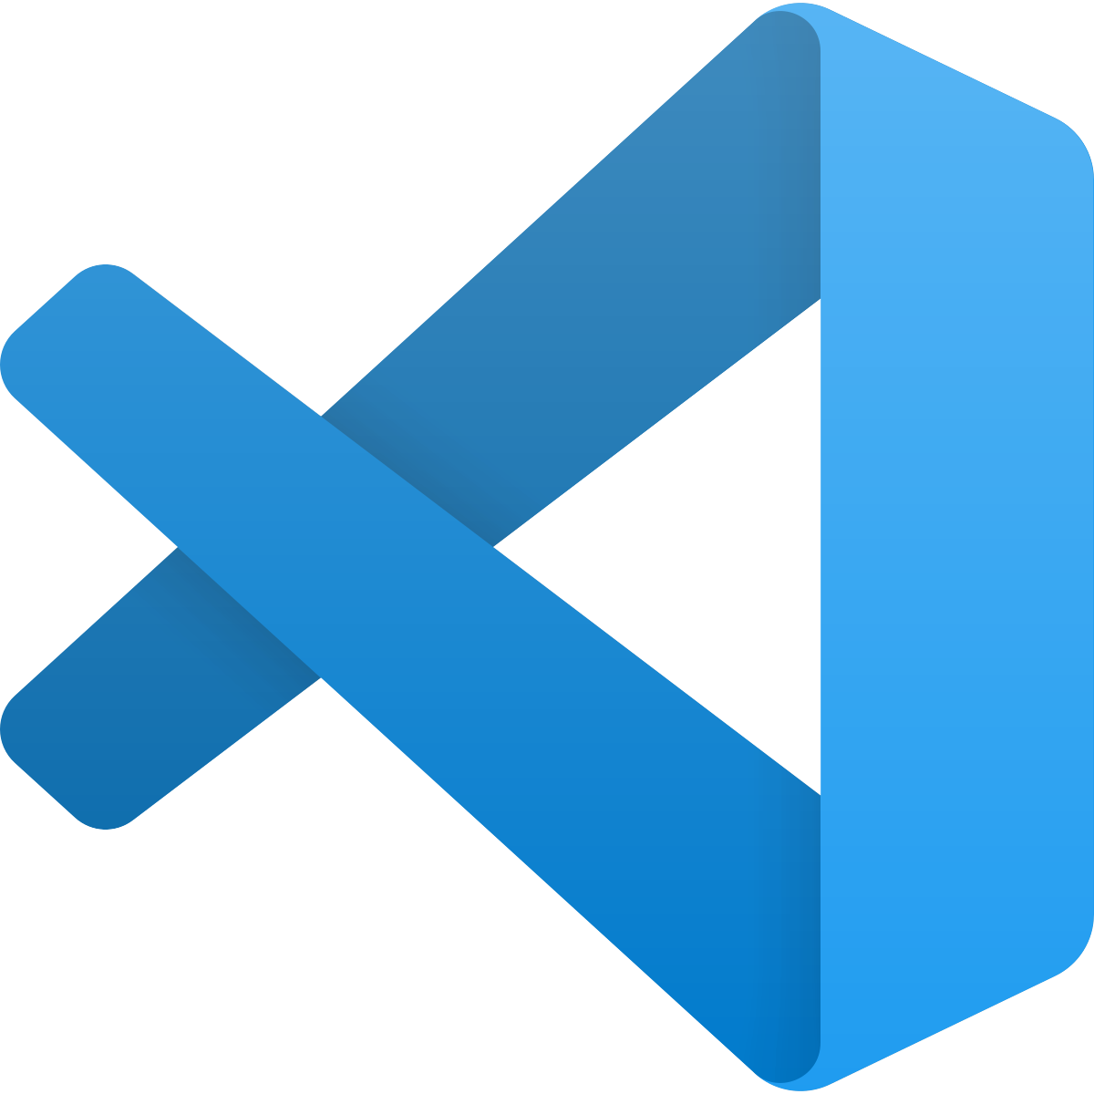
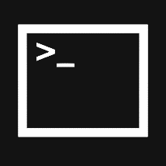



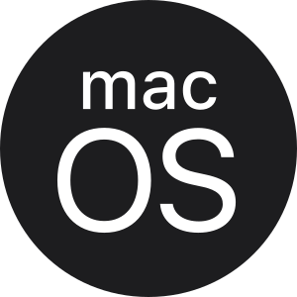




Build anything with a unified platform
Design complete 10/11
.NET
Cloud
Web
Desktop
Mobile
Gaming
IoT
AI
+
+
Visual Studio
Visual Studio Code
CLI
GitHub Copilot
Windows
Linux
macOS
NuGet
GitHub
.NET Aspire
Components, tools, library vendors
Tools
Operating system
Ecosystem
Notes:
[JAMES]
Our mission is to delight developers
It is to empower you to build the apps, services, and solutions you desire with a world class unified developer platform, productive developer tools, and a thriving ecosystem.

Slide 8
Every App Needs
Observability
Resiliency
Scalability
Manageability
Notes:
No matter what type of application you're building every single application needs to be observable to get deep insights while you're debugging your application and while it's out into production. Additionally, they need to be resilient which means that no matter what the Internet connectivity is or the environment they need to be always up and running not only on the front end but also on the back end. They have to be scalable your application today much of serve a few 100 people but what happens when it serves 10s of thousands or hundreds of thousands of users. And finally, as a developer we want to be able to easily manage our application and easily deploy them so we can continuously and rapidly iterate on our apps.

Slide 9
.NET gives you a lot in the box
Observability
Resiliency
Scalability
Manageability
Built in metrics with dimensions
New Polly based resiliency packages
AOT (increased density)
Certificate auto-rotation support in Kestrel
DI integration for metrics
SignalR Stateful Reconnect
Performance
Better Logging support (faster, can object serialization)
Chiseled Ubuntu
Enrichment
Redaction
Testing fakes for Logging & Metrics
Notes:
Now inside of .NET you have the ability to not only build these applications but integrate into all of these different parts and in .NET eight the team added even more goodness across all of these different key areas for developers. This means at your fingertips you can easily integrate different NuGet packages and services from the frameworks into your applications to make them more observable resilient scalable and manageable in the long run.

Slide 10
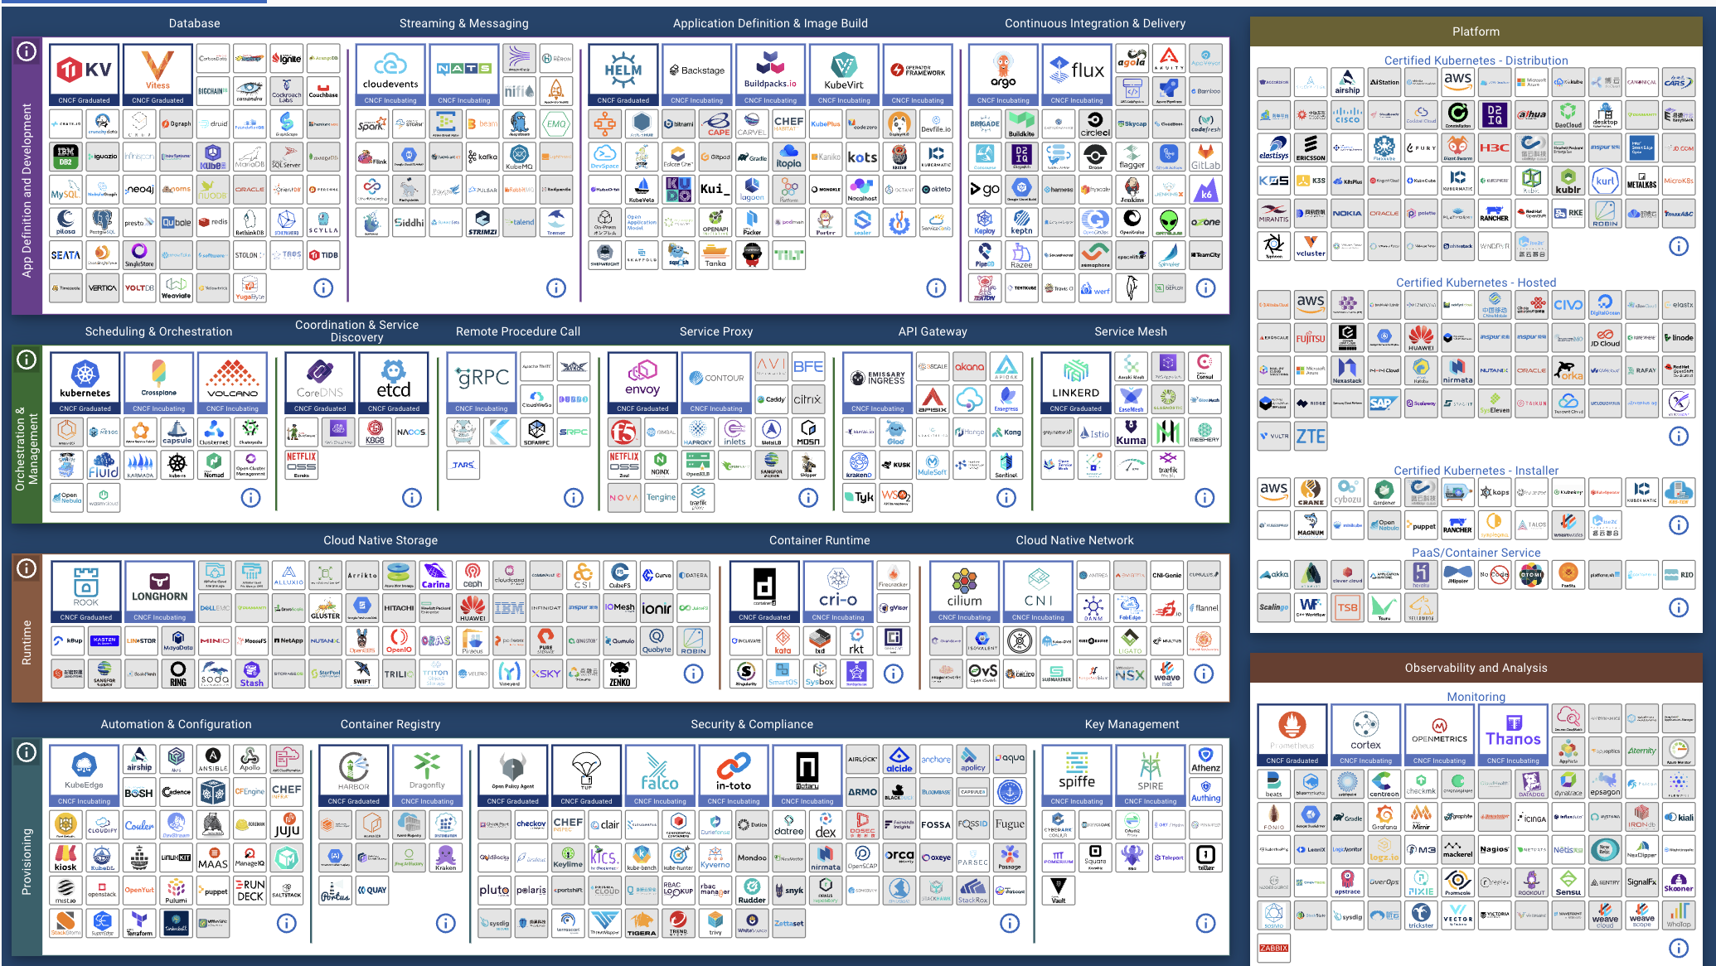
CNCF Cloud Native Landscape
landscape.cncf.io

Slide 11
Powerful tools, templates, and packages for building observable, production-ready apps
Streamlined Inner-Loop
Developer Dashboard
Integrations
Deployment
Extensible, OpenTelemetry Built-in, & Ready for Any Cloud

Slide 12
Streamlined Inner-Loop
C# App Host
Developer Dashboard
Integrations
Logs, metrics, + traces
Pre-configured NuGets
Optionally generated manifest
Deployment
Developer Dashboard
Standalone in Azure

Slide 13
Demo: Aspireifying your App
Damian Edwards

Slide 14
Streamlined Inner-Loop
Streamlined Inner-Loop

Slide 15
Health Checks in .NET Aspire
GET /health
builder.Services.AddHealthChecks()
// Add a default liveness check to ensure app is responsive
.AddCheck("self", () => HealthCheckResult.Healthy(), ["live"]);
Notes:
Health checks are crucial for monitoring the status and performance of applications in .NET Aspire. Integrating health checks improves observability, allowing developers to track the application's health effectively. Automated health checks enhance the overall reliability and uptime of applications, ensuring they run smoothly and efficiently.

Slide 16
Managing Containers
More flexible startup and lifecycle options
var myDB = builder.AddPostgres("myDB")
.WithLifetime(ContainerLifetime.Peristent);
builder.AddProject<MyProject>("myProject")
.WithReference(myDB)
.WaitFor(myDB);

Slide 17
Developer Dashboard
Developer Dashboard

Slide 18
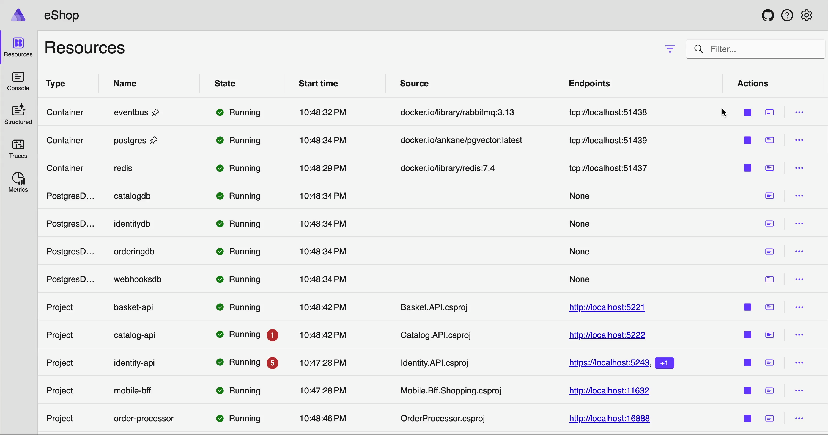
Stop and Restart

Slide 19
Demo: Custom Commands

Slide 20
Aspire Samples Repo
github.com/dotnet/aspire-samples

Slide 21
Python via Dockerfile
App Host
var stage = builder.ExecutionContext.IsRunMode ? "base" : /* default stage */ null;
var pythonInference = builder.AddDockerfile("python-inference", "../PythonInference", "Dockerfile", stage)
.WithHttpEndpoint(port: 57000, targetPort: 8000)
.WithContainerRuntimeArgs("--gpus=all")
.WithLifetime(ContainerLifetime.Persistent);
if (builder.ExecutionContext.IsRunMode)
{
// Mount app files into the container & enable auto-reload when running in development
pythonInference
.WithBindMount("../PythonInference", "/app")
.WithArgs("--reload");

Slide 22
Python via Integration
App Host
builder.AddPythonApp("python-inference", "../PythonInference", "-m", ["uvicorn", "main:app"])
.WithHttpEndpoint(env: "UVICORN_PORT", port: 62394);

Slide 23
var stage = builder.ExecutionContext.IsRunMode ? "base" : /* default stage */ null;
var pythonInference = builder.AddDockerfile("python-inference", "../PythonInference", "Dockerfile", stage)
.WithHttpEndpoint(port: 57000, targetPort: 8000)
.WithContainerRuntimeArgs("--gpus=all")
.WithLifetime(ContainerLifetime.Persistent);
if (builder.ExecutionContext.IsRunMode)
{
// Mount app files into the container & enable auto-reload when running in development
pythonInference
.WithBindMount("../PythonInference", "/app")
.WithArgs("--reload");
}
var pythonInference = builder.AddPythonApp("python-inference", "../PythonInference", "-m", ["uvicorn", "main:app"])
.WithHttpEndpoint(env: "UVICORN_PORT", port: 62394);

Slide 24
Integrations
Integrations

Slide 25
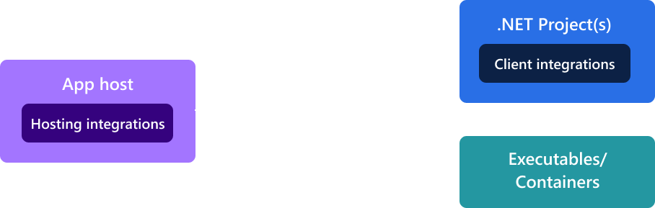

Slide 26
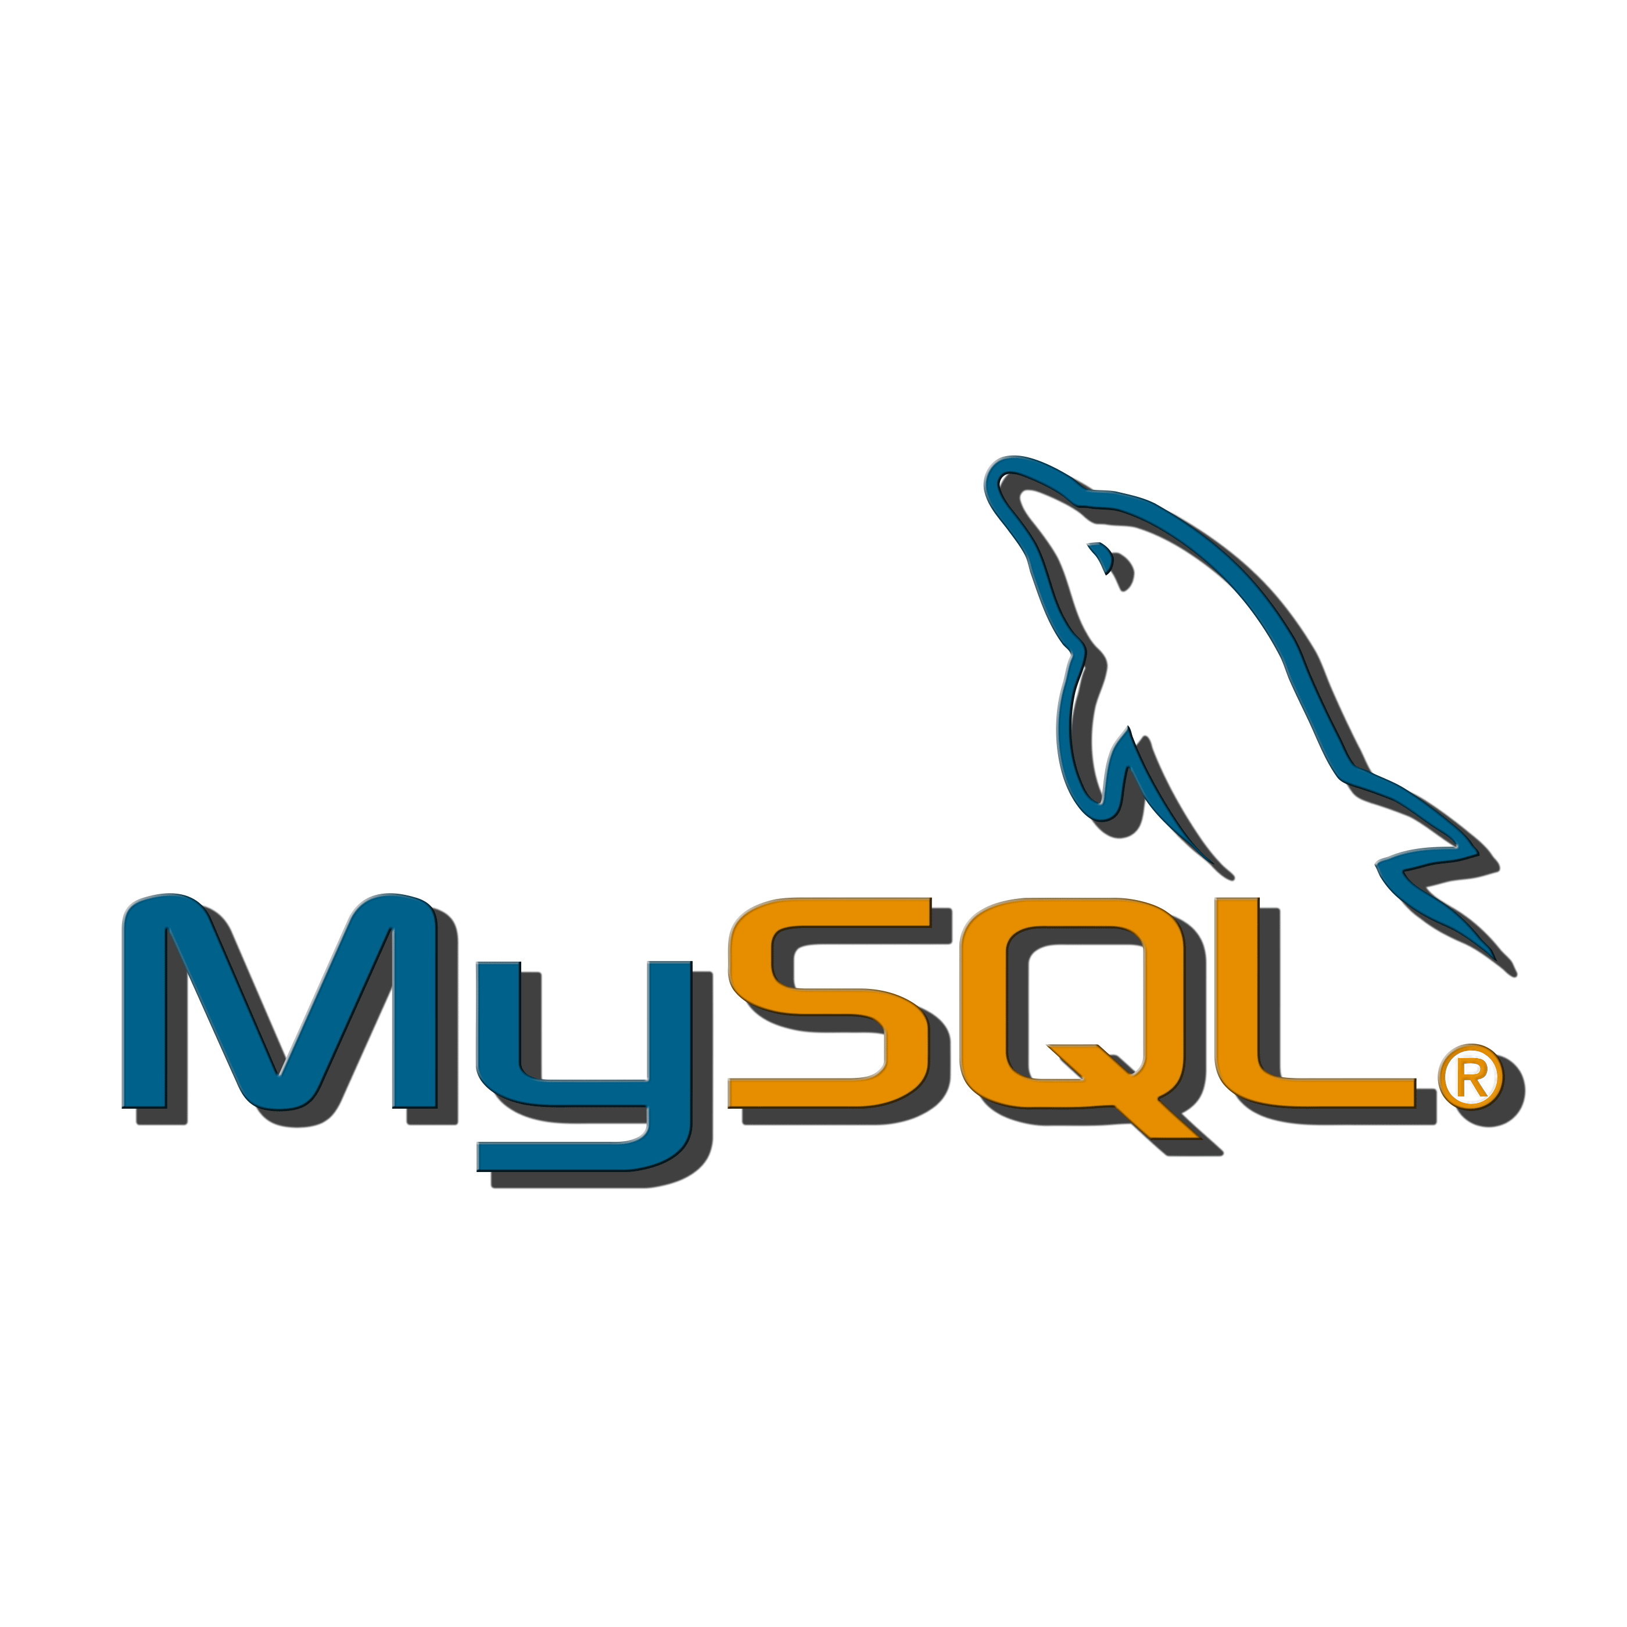
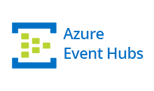
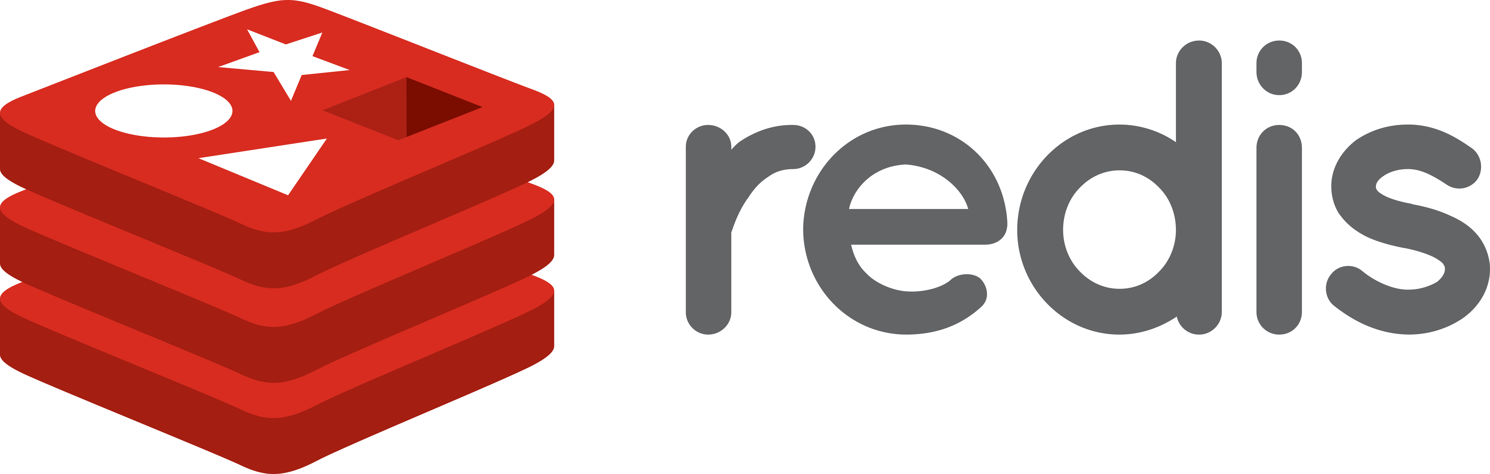
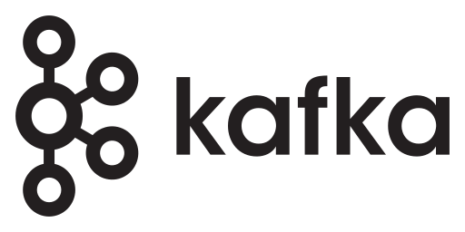
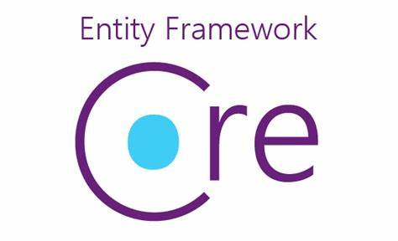


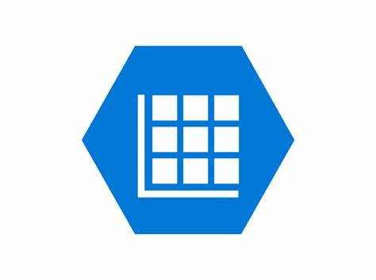
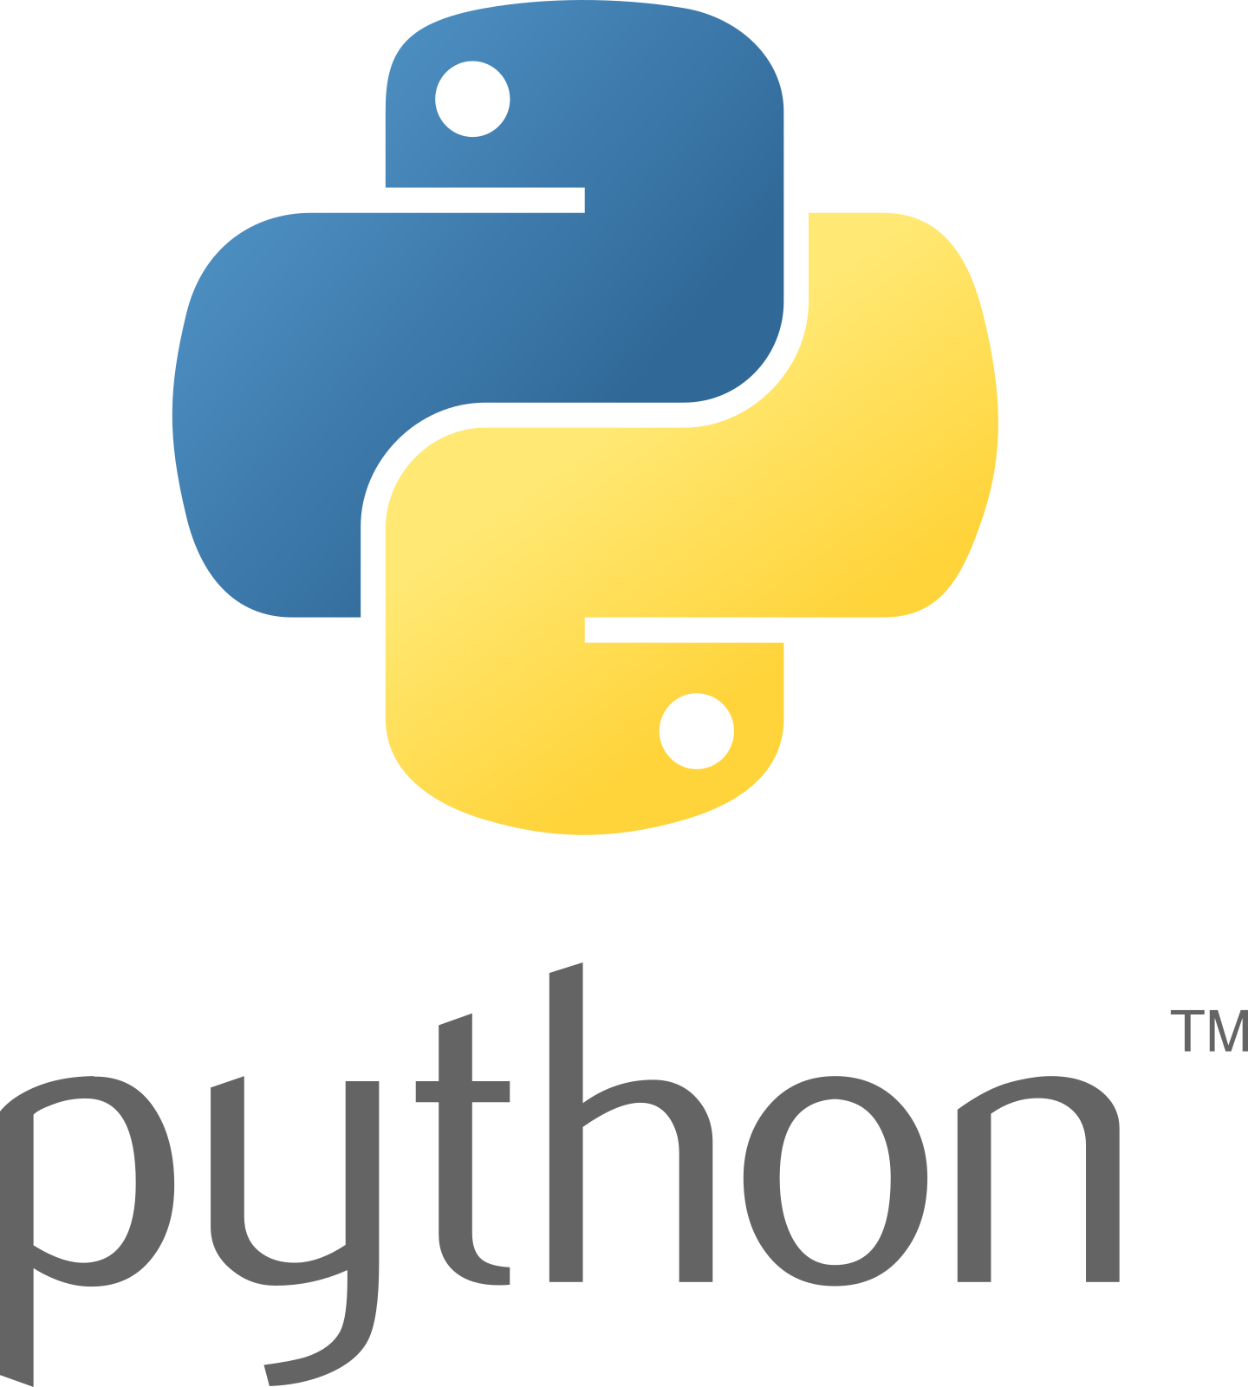

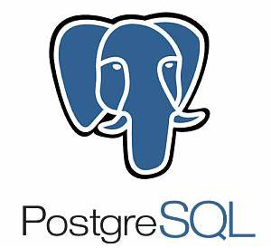


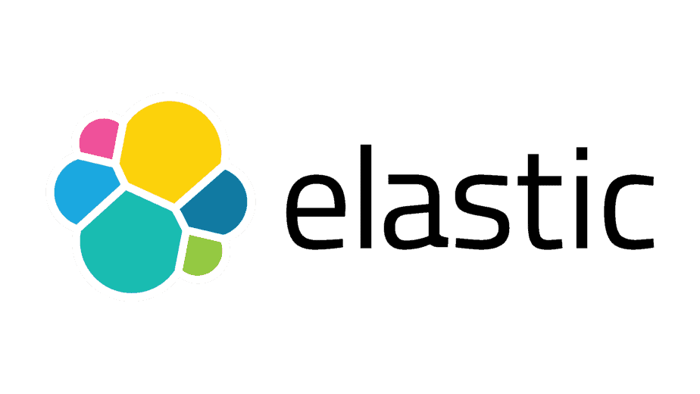

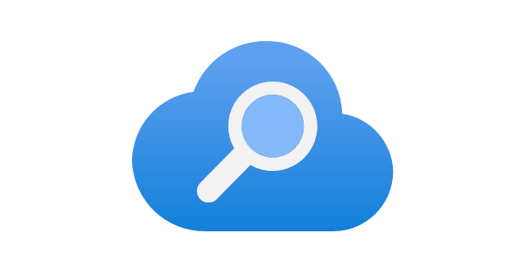
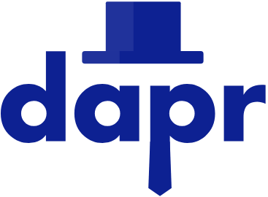
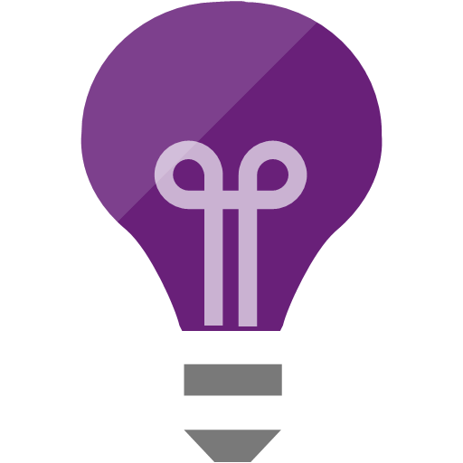
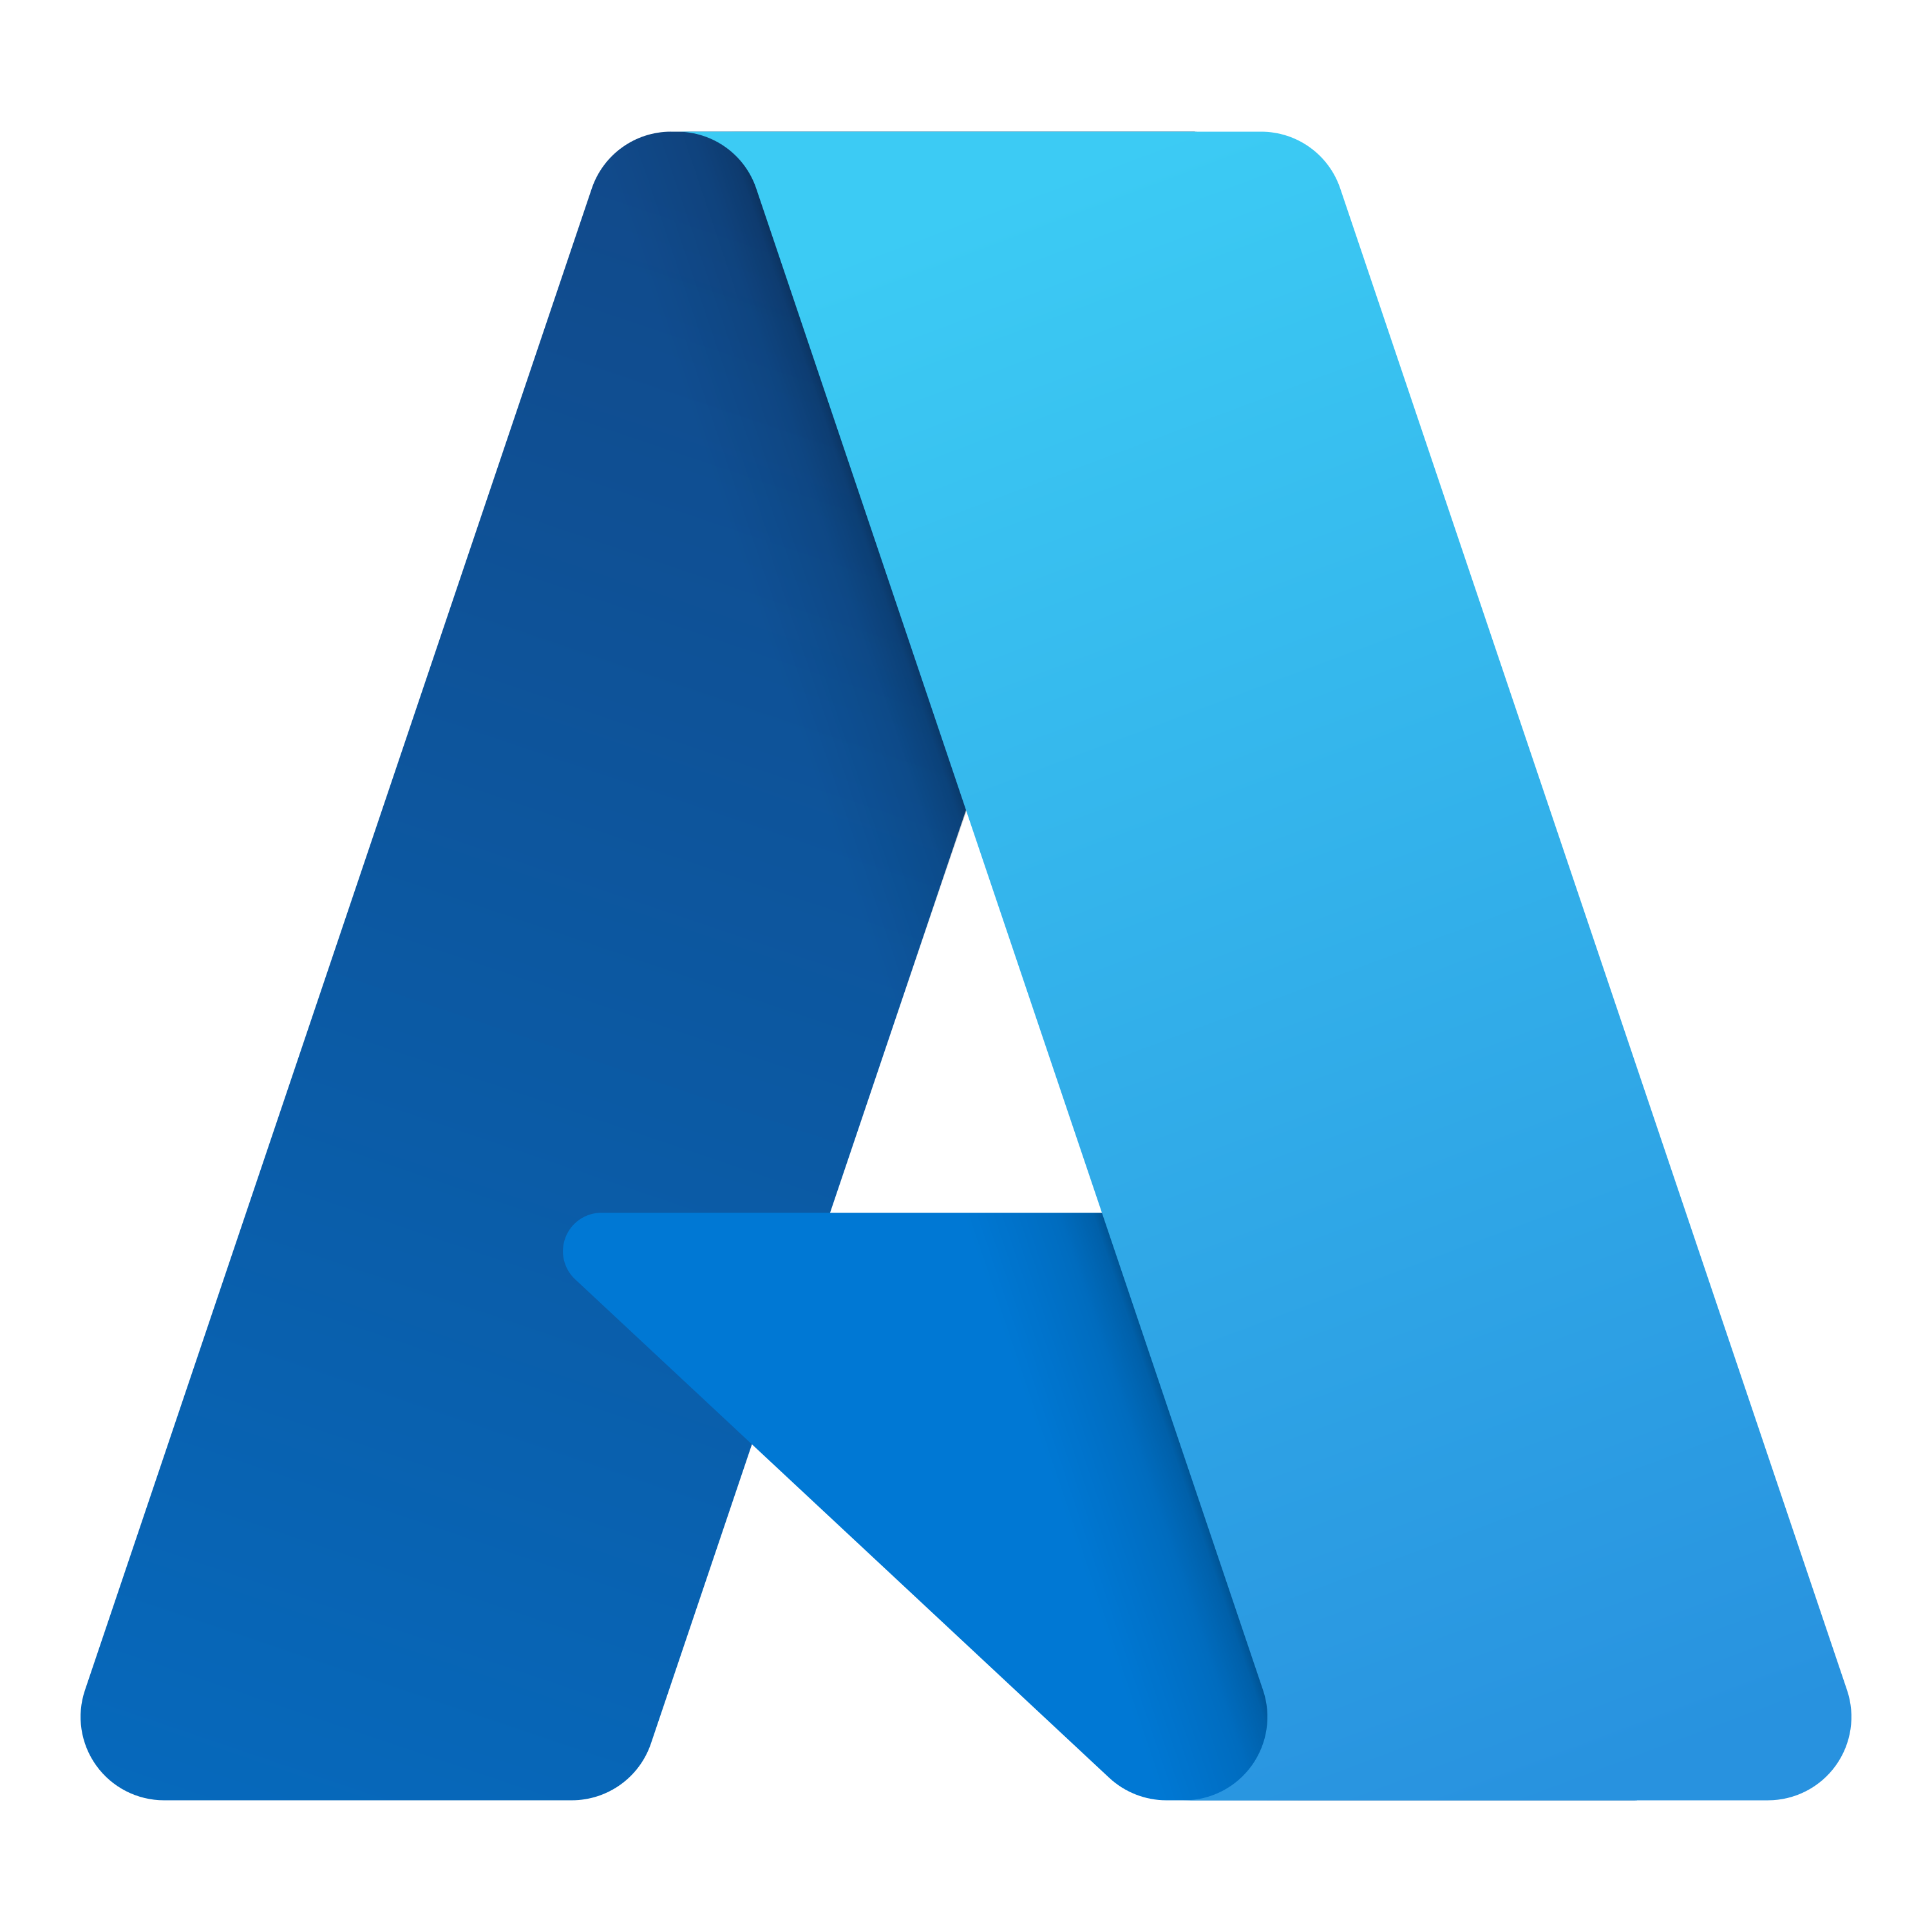
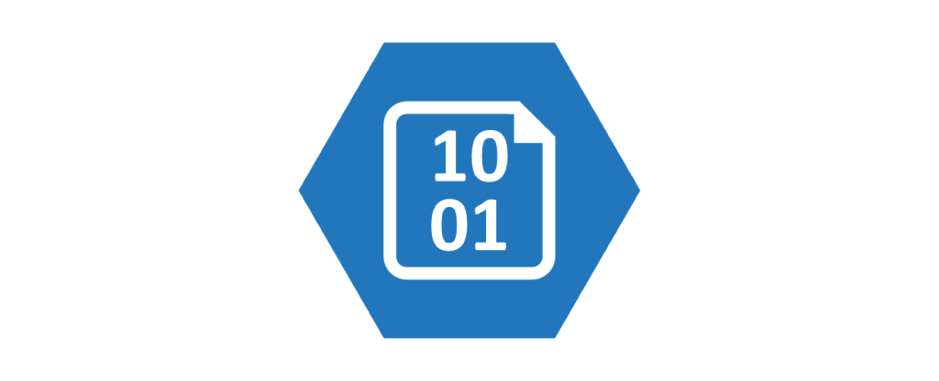


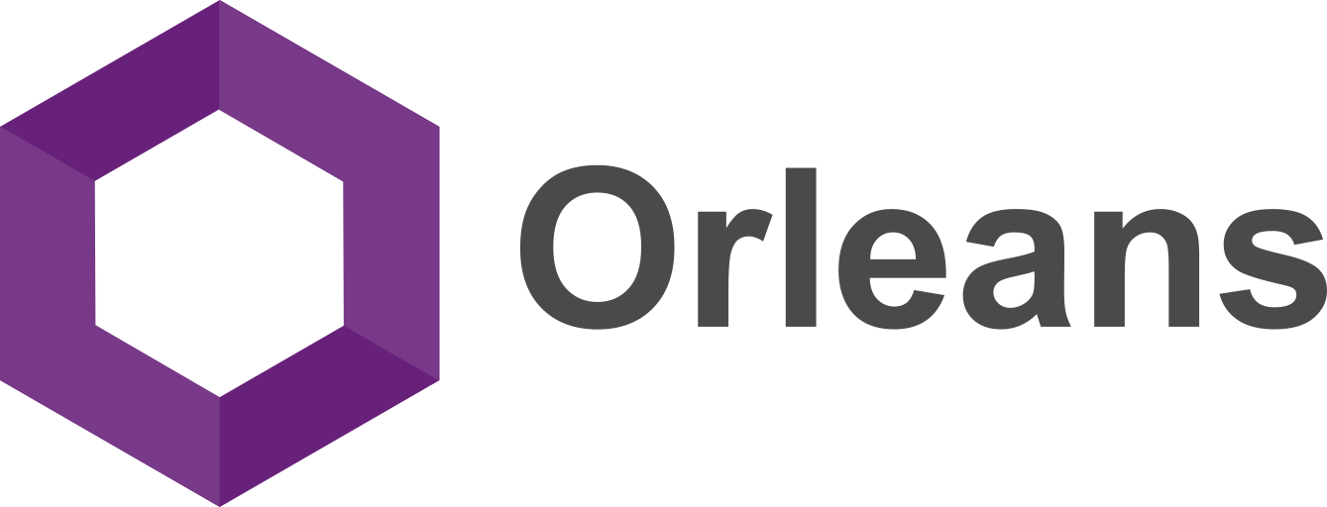
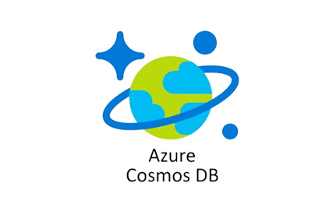
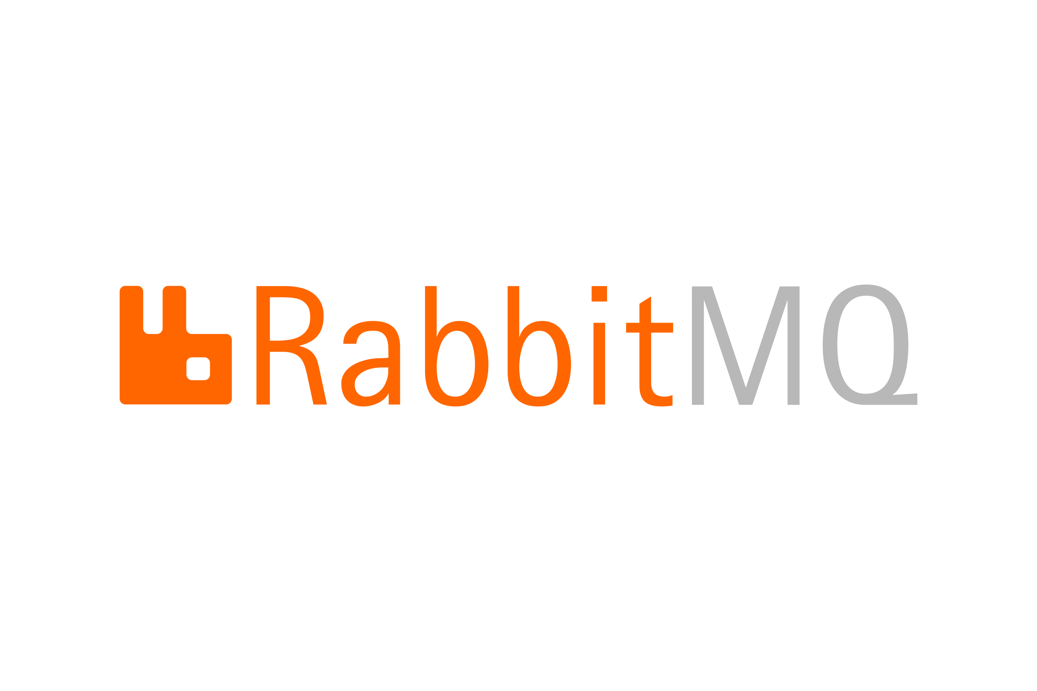
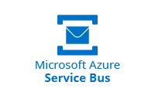

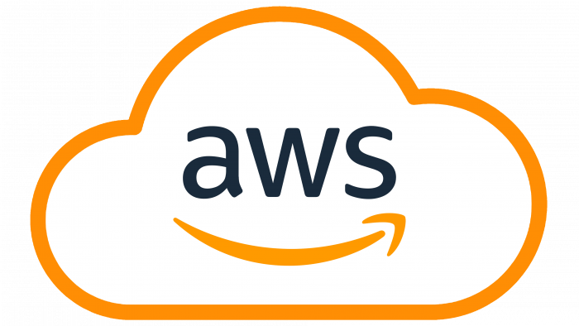

.NET Aspire Integrations

Slide 27




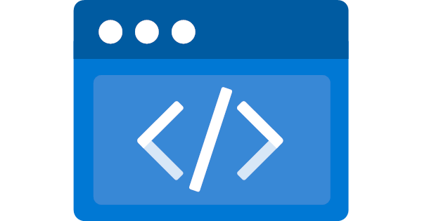
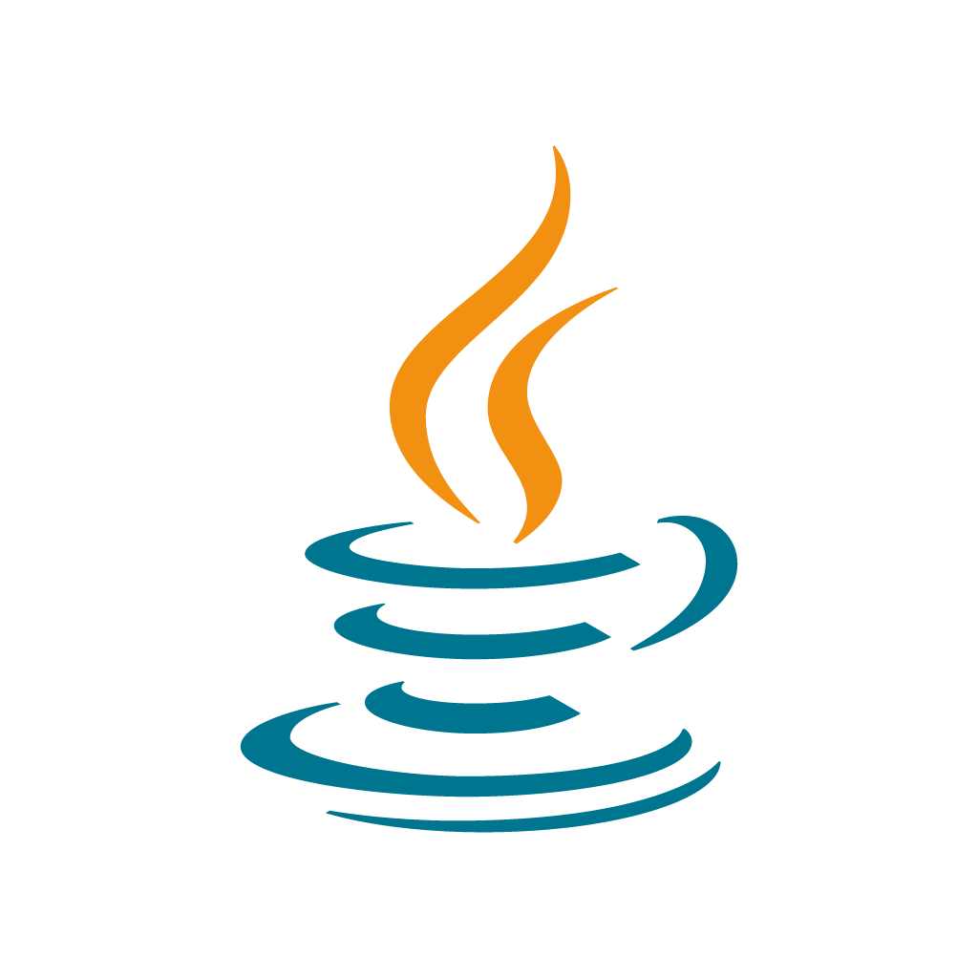


.NET Aspire Community Toolkit
github.com/CommunityToolkit/Aspire
Notes:
Azure static web apps, golang deno and java hosting integrations,

Slide 28
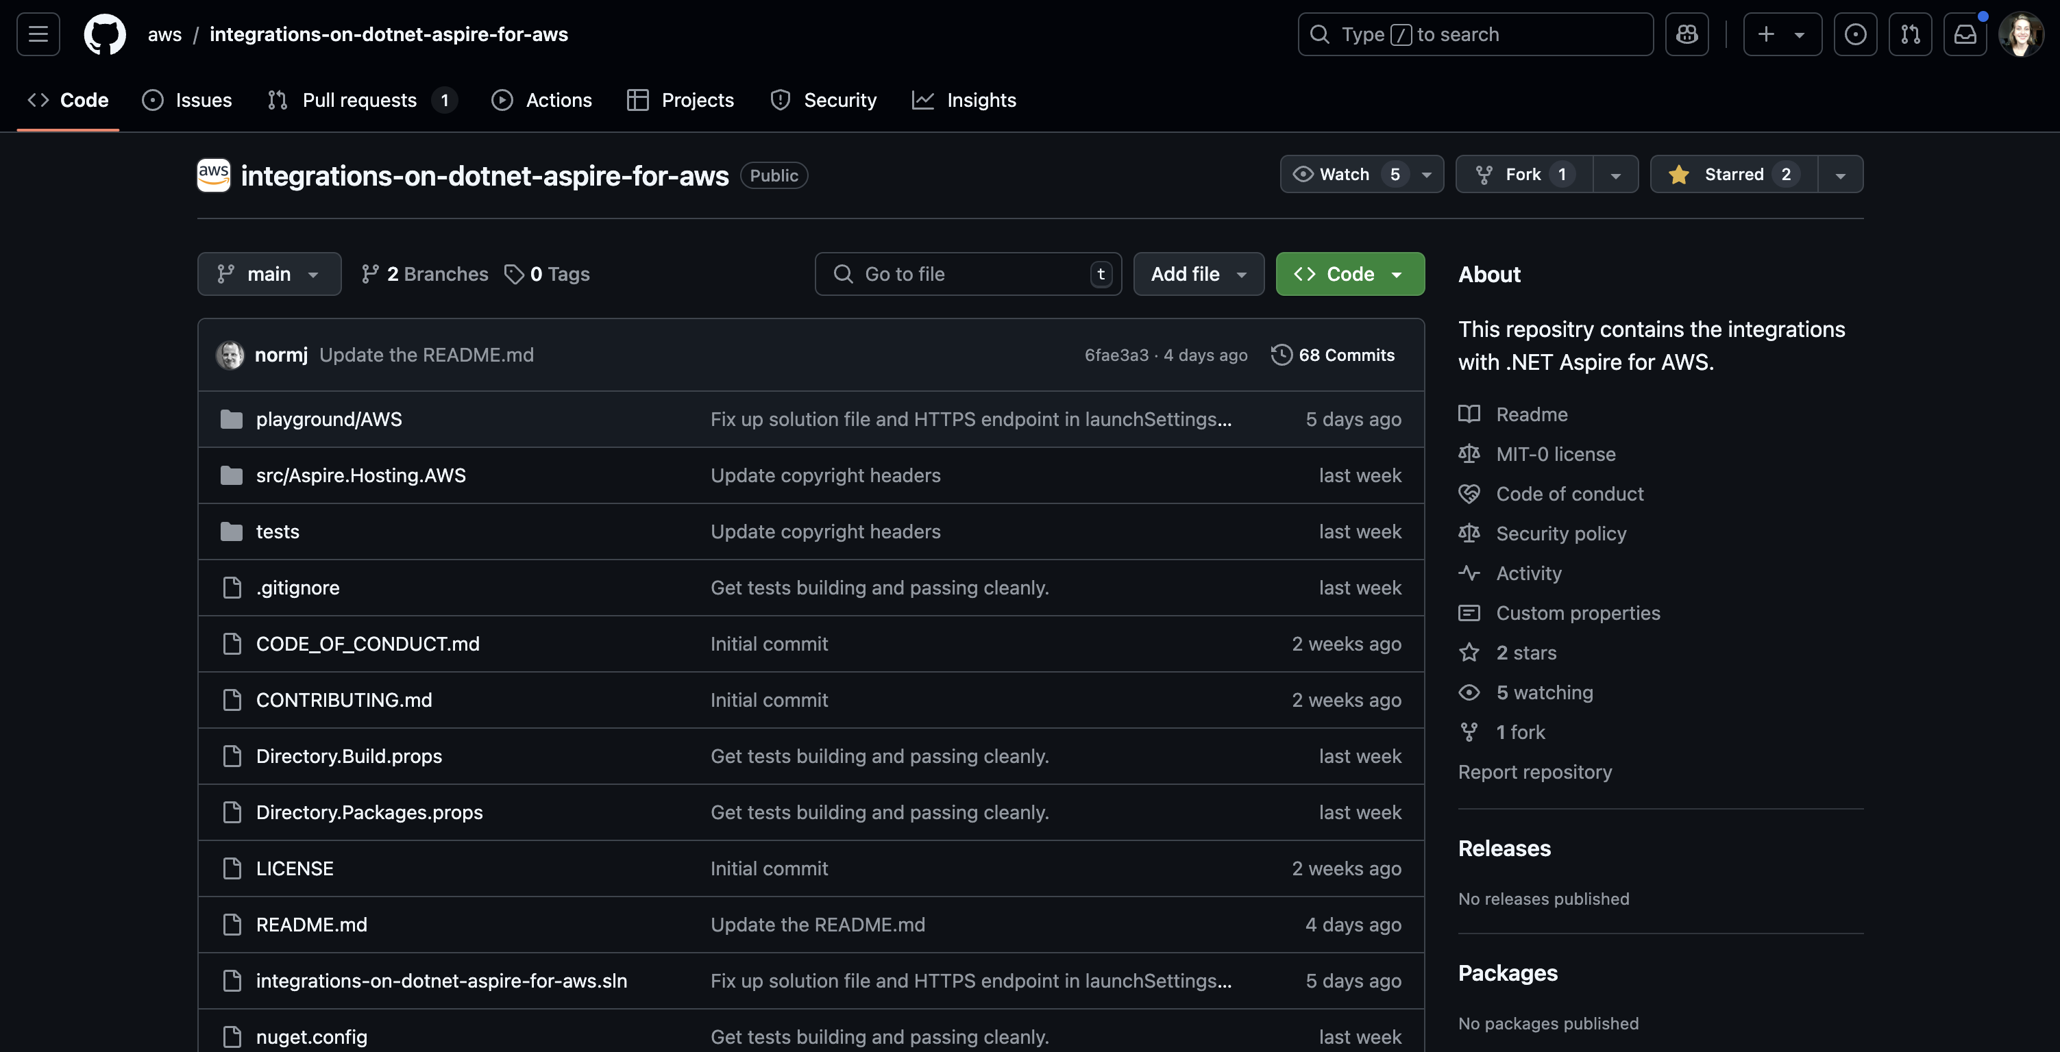

Slide 29
Azure Functions - Now in Preview
Support for running Azure Functions in your Aspire AppHost
More deployment options are in development

Slide 30
Deployment
Deployment

Slide 31







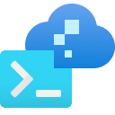
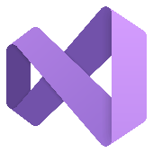




Flexible Deployment with .NET Aspire
How You Do It Today!
AWS CDK
Azure Dev CLI
Visual Studio

Slide 32

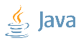




Run your containers your way for different needs
Simplicity
Control
Azure Container Apps
Azure Kubernetes Service
Time to market
Scale to zero
Embedded app patterns
More dev, less ops
Industry standard
OSS ecosystem access
Customization
Rich access policies
Notes:
Native dotnet container publish support – dotnet has the ability to publish containers built in, without any dockerfile

Slide 33
More Customized Deployments
builder.AddProject<ApiService>(“api”)
.PublishAsAzureContainerApp((module, app) =>
{
app.ConfigureCustomDomain(customDomain, certificateName);
app.Template.Scale.MinReplicas = 0; };

Slide 34
Customized Azure Container App Deployments
App Host
builder.AddProject<ApiService>(api”)
.PublishAsAzureContainerApp((module, app) =>
{
app.ConfigureCustomDomain(customDomain, certificateName);
app.Template.Scale.MinReplicas = 0;
};

Slide 35
Get .NET 9
Download .NET 9 aka.ms/get-dotnet-9

Slide 36
Resources
Links
More at .NET Conf
Learn about .NET Aspire
Azure Functions with Safia Abdalla + Matthew Henderson
aka.ms/dotnet/aspire
Wednesday, 10am PST
Get started
Aspirations for Aspire with David Fowler
aka.ms/dotnet/aspire/start
Wednesday, 10:30am PST
.NET Aspire Samples
Community Toolkit with David Pine + Aaron Powell
github,com/dotnet/aspire-samples
Wednesday, 4:30pm PST
Aspire on AWS with Norm Johanson + Scott Hunter
.NET Aspire on GitHub
github.com/dotnet/aspire
Thursday, 12pm PST

Slide 37
Thank you!

